Slide 1
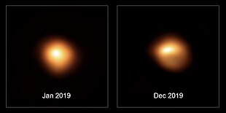
Variable Star Classification:
Data Preparation
Sage and Jalal (Multimodal Maestros)

Slide 2
Previous solutions
“Periodic variable star classification with deep learning: handling data imbalance in an ensemble augmentation way”
To clean the dataset, used phase-folded light curves and excluded points with extra high deviation/error values
Deals with class imbalance by generating artificial light curves for data augmentation, applying Gaussian Process
Best model reached about 86% overall accuracy, with the most misclassifications coming from the classes with the least data
“The ASASSN catalogue of variable stars: The Serendipitous Survey”
Used a random forest classifier, trained on 16 variability features
Model was designed to classify 10 distinct classes of stars
Removed variables with irregular characteristics from consideration
Notes:
jalal

Slide 3
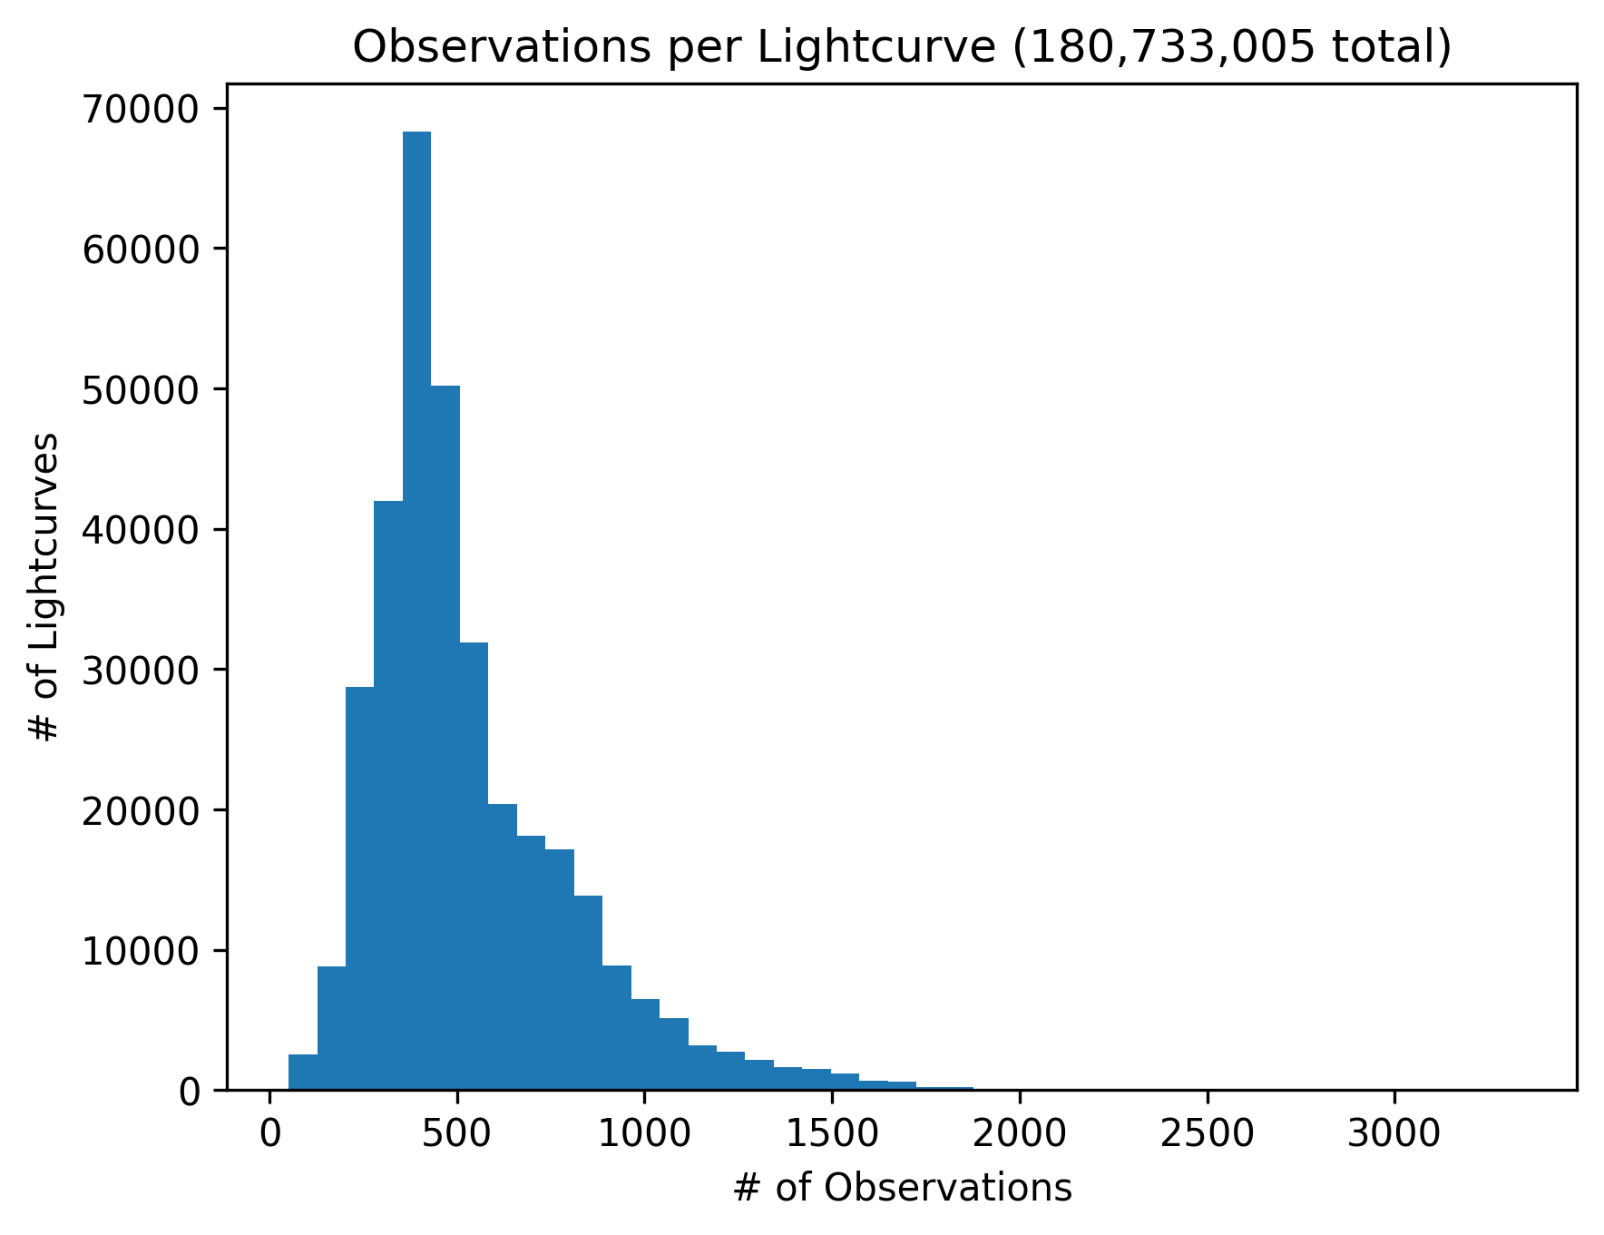
Data Overview
378,319 lightcurves, 180,733,005 observations
Time, apparent mag (brightness), mag err, FWHM
We divided the data to 70% training, 20% validation, and 10% testing.
We're storing/accessing this on EBS on an EC2 instance
Gabor pls give us money for this and for an elastic vpc allocation
Notes:
sage

Slide 4
Data challenge: distance
Basics:
The stars observed in this dataset are at a variety of distances from Earth
Two stars of equal intrinsic luminosity observed from different distances will appear to differ in brightness
From this, a problem:
The variation in amplitude and mean of the lightcurves is partially a function of distance. We're trying to determine star classification, which is not a (meaningful) function of distance, though distance does skew class frequency. If we do not correct this, the model could learn the wrong features from the data.
Notes:
jalal

Slide 5

Our solution: Gaia mission
Gaia: parallax (distance) measurements for 1.5+ billion stars
Strategy:
Join ASASSN dataset with Gaia Data Release 3 to get distances
Calculate absolute magnitude (distance-independent measurement of intrinsic brightness) from the lightcurve mags and the Gaia distances
Propagate Gaia distance uncertainties to absolute magnitude uncertainties
Absolute magnitude and abs mag uncertainties will be inputs for our model
Notes:
sage

Slide 6
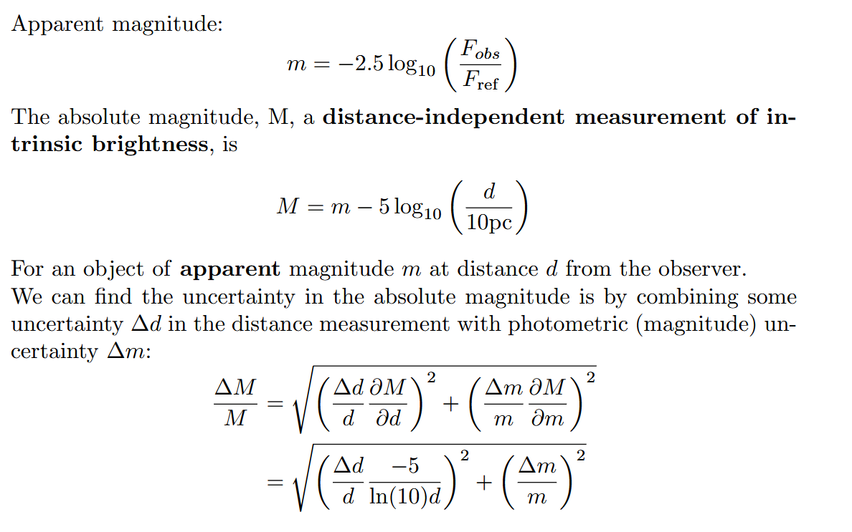
Notes:
sage

Slide 7
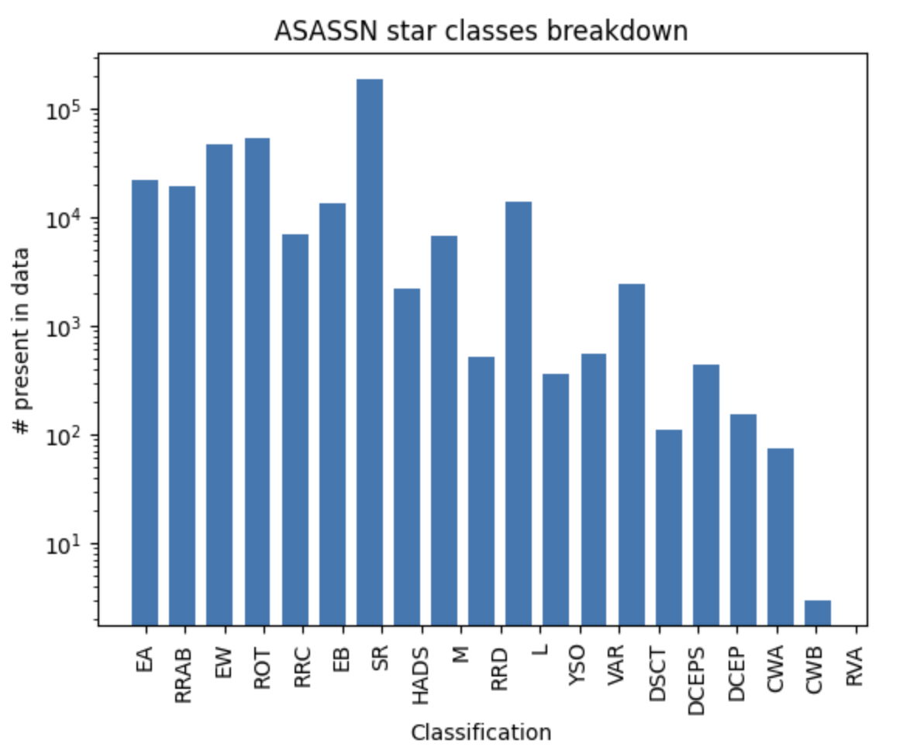
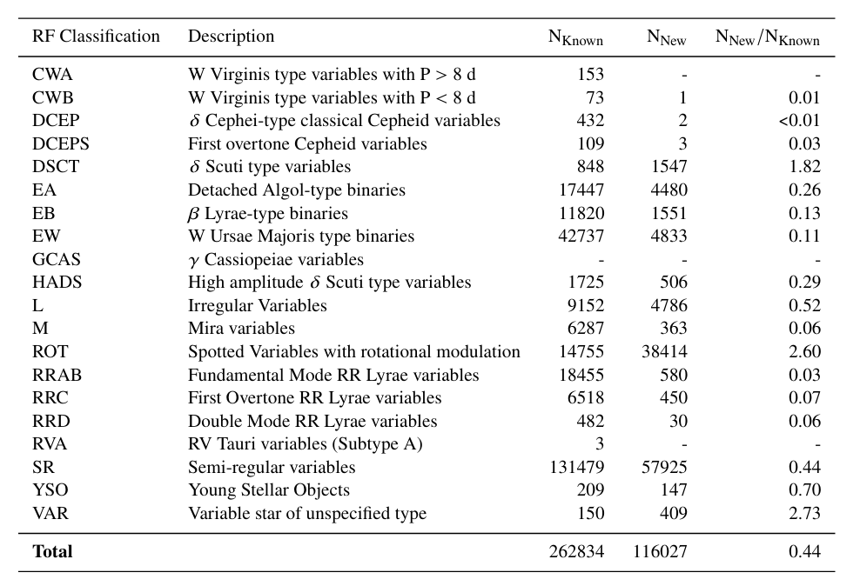
Biggest data challenge: class imbalance
Notes:
jalal

Slide 8
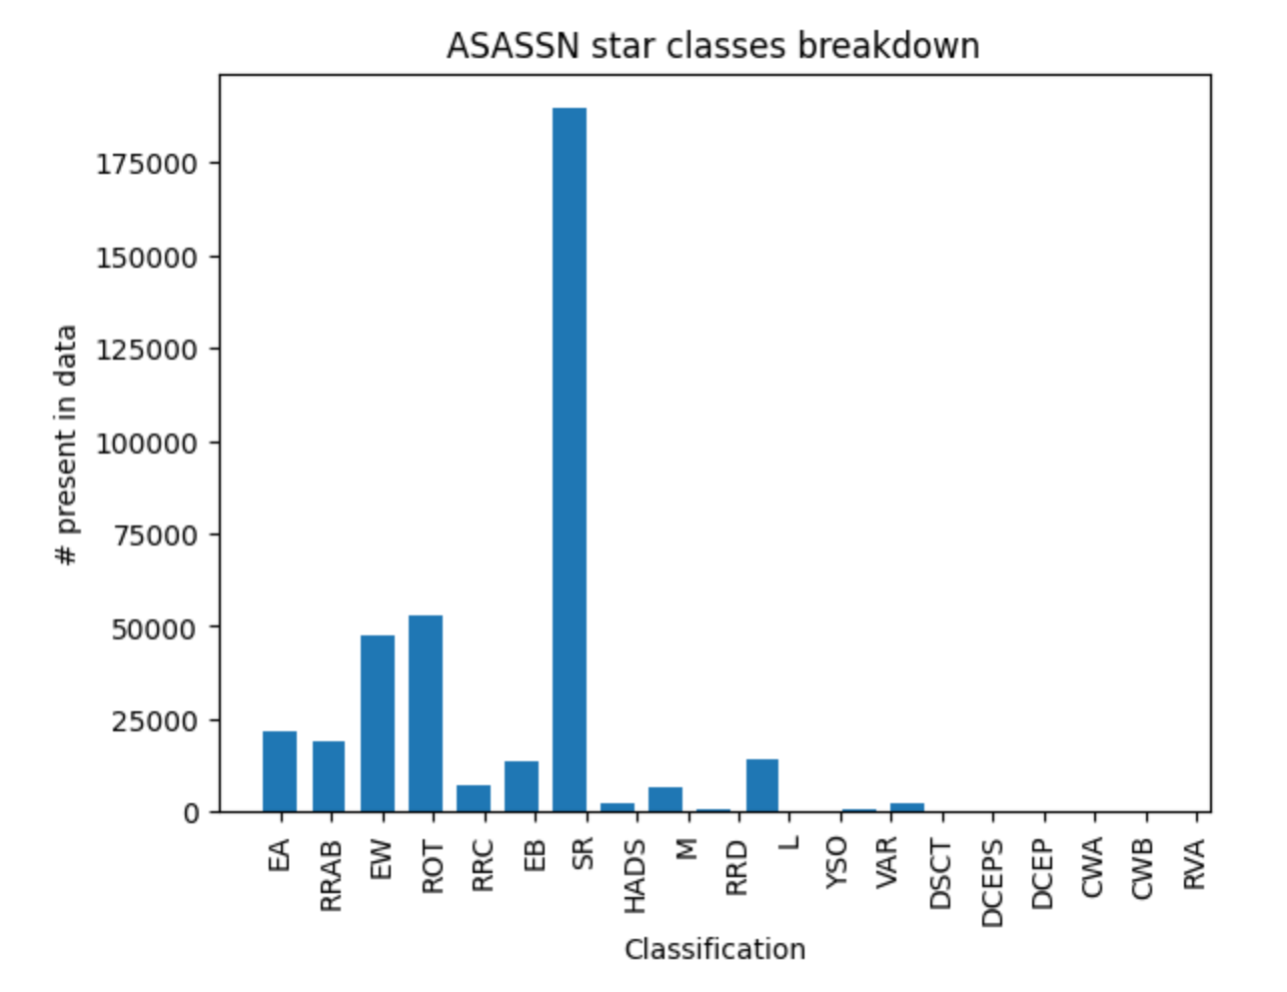
Biggest data challenge: class imbalance
Notes:
jalal

Slide 9
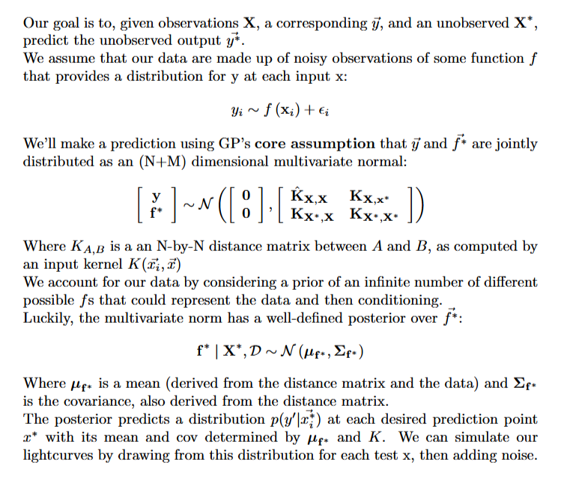
Our solution: Gaussian Processes
Notes:
sage

Slide 10
GP Cont.
Scikit optimizer and Markov Chain Monte Carlo simulation for hyperparameter selection + uncertainty estimation
Number of points drawn from a distribution resembling the dataset
To simulate x (time) values
density kernel
number of points is similar to input length
choose a random sub-sequence from the generated curve over a time range similar to the input time range
Order of ops:
Train-val-test split
Break train into subsets
equal # of classes in each of 10 subsets
Augment subsets so that there are 1000 of each class in each subset
either remove curves or GP-generate new ones
Notes:
sage

Slide 11
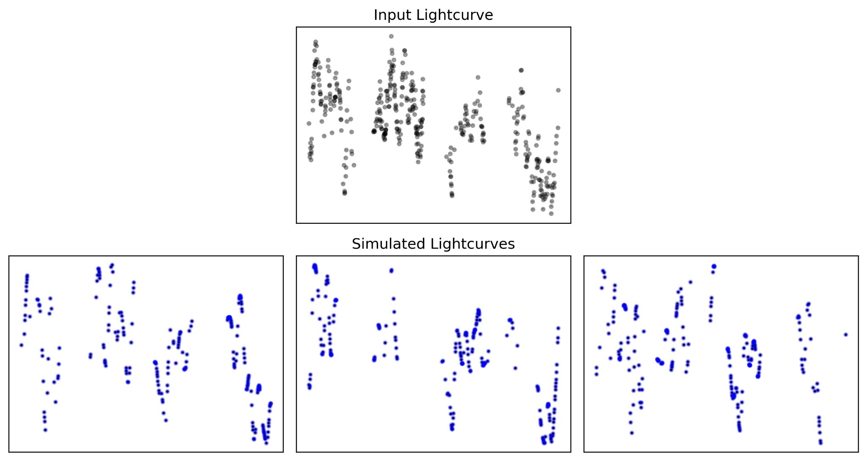
Notes:
jalal

Slide 12
Ongoing Work
Data synthesization / augmentation is compute-intensive
Ongoing reading on different population-level standardization techniques for complex time-series
Standard method of z-normalization may not be appropriate
Data is already zero-pointed (elimination of systematic telescope bias)
Normalization can sometimes be harmful for data of this type (Hoppner 2014)
Modification of dataset size to address compute constraints
Notes:
sage

Slide 13
Bibliography
Boone, Kyle. Avocado: Photometric Classification of Astronomical Transients with Gaussian Process Augmentation. 11 July 2019. arXiv.org, https://doi.org/10.3847/1538-3881/ab5182.
Höppner, Frank. “Less Is More: Similarity of Time Series under Linear Transformations.” Proceedings of the 2014 SIAM International Conference on Data Mining (SDM), Society for Industrial and Applied Mathematics, 2014, pp. 560–68. epubs.siam.org (Atypon), https://doi.org/10.1137/1.9781611973440.65.
Jayasinghe, T., et al. “The ASAS-SN Catalog of Variable Stars I: The Serendipitous Survey.” Monthly Notices of the Royal Astronomical Society, vol. 477, no. 3, July 2018, pp. 3145–63. arXiv.org, https://doi.org/10.1093/mnras/sty838.
Kang, Zihan, et al. “Periodic Variable Star Classification with Deep Learning: Handling Data Imbalance in an Ensemble Augmentation Way.” Publications of the Astronomical Society of the Pacific, vol. 135, no. 1051, Sept. 2023, p. 094501. arXiv.org, https://doi.org/10.1088/1538-3873/acf15e.

